Slide 1
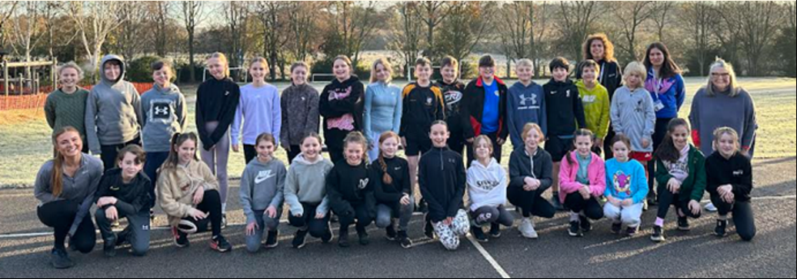
2024 KS2 SATs
Feel free to take a look at some of the past papers.
Childer Thornton Primary School

Slide 2
It doesn’t define them!
They are still ace kids who work really hard!

Slide 3
What are SATs?
Statutory assessment tests
A legal requirement
All Year 6s in England sit the tests
They now measure a child’s attainment at the end of KS2:
English
Reading
SPAG (spelling, punctuation and grammar)
Mathematics
Arithmetic and Reasoning
(Writing - teacher assessment)

Slide 4
What will be tested?
Maths
Paper 1 - Arithmetic (30 minutes)*
Paper 2 – Reasoning (40 minutes)
Paper 3 – Reasoning (40 minutes)
English
Reading – 1 hour to read and answer questions based around 3 different texts
Spelling Punctuation and Grammar
Paper 1 – Questions (45 minutes)
Paper 2 – Spelling test – 20 spellings
Writing is continuously assessed throughout the year.

Slide 5
SATs WEEK
Monday 13th May
to
Thursday 16th May

Slide 6
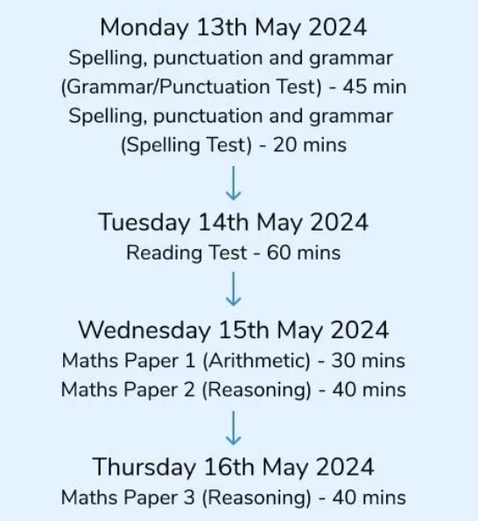
Timetable for SATs Week:

Slide 7
Why are SATs important?
Like any other formal examination process.
Give you information about where your child is at (academically).
Informs secondary schools of academic ability and this information is sometimes used for target setting.
Often, high schools re-assess upon entry.

Slide 8
They will be ready!
Children will be assessed on areas covered throughout KS2 and then revised again in Year 6.
The children have already practised completing the ‘magic papers’ during assessment weeks throughout the year.
They know how the process works and how to complete the papers.
They are prepared as best as they can be!

Slide 9
Assessment and Reporting

Slide 10
Standard Score
For the first publication of test results, each pupil now receives:
A raw score (number of raw marks awarded).
A scaled score in each tested subject.
This is confirmation of whether or not they attained the national standard.

Slide 11
Scaled scores
It is planned that 100 will always represent the ‘national standard’.
Each pupil’s raw test score will therefore be converted into a score on the scale, either at, above or below 100.
A child who achieves the ‘national standard’ (a score of 100) will be judged to have demonstrated sufficient knowledge in the areas assessed by the tests.

Slide 12
Scaled Scores
On publication of the test results in July:
EXP - A child awarded a scaled score of 100 is judged to have met the ‘national standard’ in the area judged by the test.
A child awarded a scaled score of more than 110 is considered to have obtained a ‘higher scaled score’.
WT - A child awarded a scaled score of less than 100 is judged to have not yet met the national standard.

Slide 13
MATHS
Three papers
Arithmetic
Reasoning
Reasoning

Slide 14
Maths
Paper 1 – Arithmetic
30 minutes (36 questions – 40 marks)
These questions aim to test the child’s ability in arithmetic.
This is a written test but they are required to use both mental and written skills.
Questions types include:
Addition and Subtraction
Calculations including decimals, percentages and fractions
Long division and multiplication

Slide 15
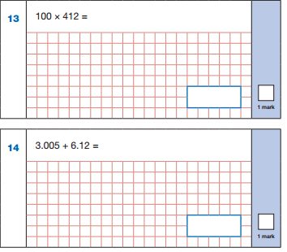
Arithmetic examples…
Notes:
Arithmetic questions

Slide 16
Maths
Paper 2 and 3 Reasoning
40 minutes (35 marks)
Many of the questions require the children to show a combination of different mathematical skills – involving multi-step problems
They need to know key concepts – volume, area, perimeter, radius

Slide 17
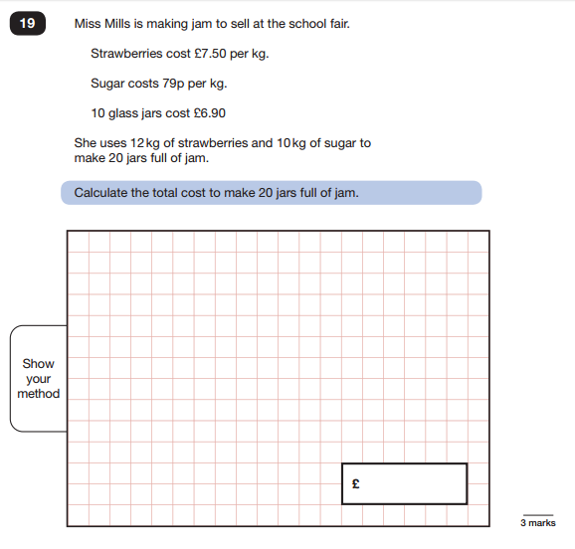
Reasoning
Notes:
Reasoning questions

Slide 18
English
Reading Test (1 hour)
Spelling Test (20 mins max – teacher led)
Punctuation and Grammar test (45 mins)
Need to remember basic skills – CL, P, Sp
Writing is assessed throughout the year by the class teacher.
Our final assessment can be moderated externally.

Slide 19
READING
1 hour
3 texts
(fiction and non-fiction)
report, story, article, leaflet, poem

Slide 20
Reading Test – 1 hour
Texts are not linked but get progressively harder
Range from 1 – 3 marks
The children are aware that the 3 markers require evidence from the text to support their answers.
Practised during shared reading sessions daily.
P – Point E - Evidence
PE, PE or PEE or PE P

Slide 21
Aspects of reading to be assessed:
Give /explain the meaning of words in context.
Retrieve and record information / identify key details from fiction and non-fiction.
Summarise main ideas from more than one paragraph.
Make inferences from the text / explain and justify inferences with evidence from the text.
Predict what might happen from details stated and implied.
Identify / explain how information / narrative content is related and contributes to meaning as a whole.
Identify / explain how meaning is enhanced through choice of language.
Make comparisons within the text.

Slide 22
Reading

Slide 23
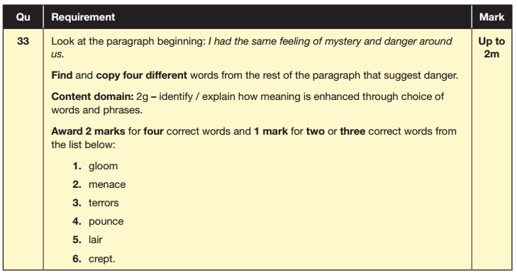

Slide 24
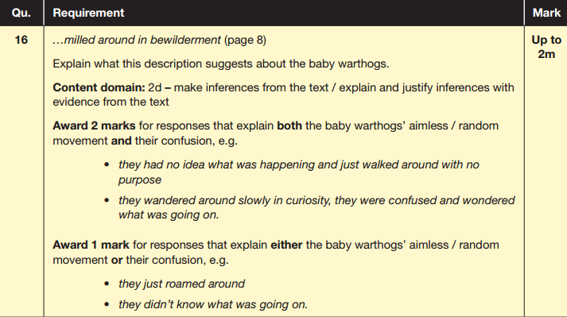

Slide 25
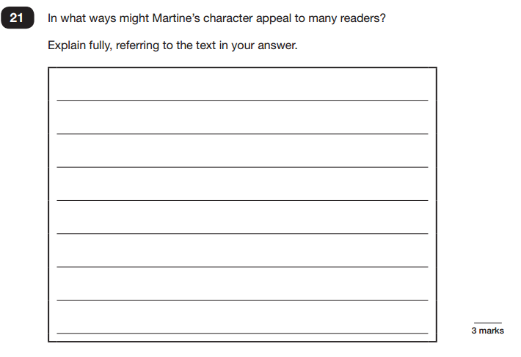
Example of a 3 mark Q

Slide 26
SPAG
45 minute punctuation and grammar test
(50 marks)
20+ minute spelling test
(20 marks)
Total 70 marks

Slide 27
SPAG
Sp in Qs
Grammatical terms / word classes
Functions of sentences
Combining words, phrases and clauses
Verb forms, tenses and consistency
Punctuation
Vocabulary
Standard English and formality
Even though the spelling is only 20 out of the 70 marks, this section is EXTREMELY important.
Spelling rules – log books
SPAG HW all year and revised in writing lessons

Slide 28
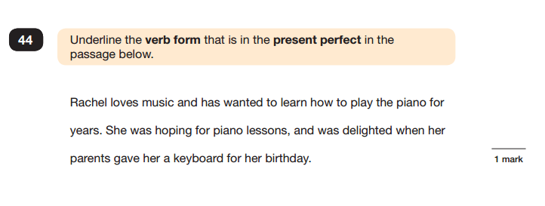

Slide 29
Mock SATs Week
We will do a practise SATs week to show the children how the whole process will play out
However, the children are used to answering the booklets and question types
This is just to show them the structure of day to reassure them more than anything

Slide 30
Homework
1x paper each week - English or maths.
1x spag.com activity – this may be a test or two short activities.
You know your children best - children can do these independently or you can sit with them.
You can mark them / go through them if you wish.
Children can time themselves or do them at a more leisurely pace.
Please let me know of any difficulties I can help your child with!!

Slide 31
What can you do to prepare your child?
Daily reading and discussion about their books.
Monitor what they are reading – appropriateness!
Practise spelling rules
Multiples – TTRS
Ensure your child completes their homework
Most importantly – don’t stress!
Your child will be working hard in school and any extra they do at home should be enjoyable.

Slide 32
How to revise:
Focus on the areas for development - not what they can do easily
Short bursts (20 minutes)
Revision guides (CGP Books)
Internet – BBC Bitesize

Slide 33
Useful websites.
www.bbc.co.uk/education/levels/zbr9wmn This is an excellent site, providing revision help for KS2, KS3, KS 4 and KS5. This covers all subjects through activities and tests.
www.parentsintouch.co.uk (this site has printable SATS papers)
www.emaths.co.uk (this site has printable SATS papers)
www.lettsrevision.com (this has details of revision guides)
http://www.cgpbooks.co.uk/pages/books.asp (these books have all your child needs to know, presented in a fun way)
http://www.parkfieldict.co.uk/sats/ English and Maths revision activities and games.
http://www.icteachers.co.uk/children/children_sats.htm A wide range of KS2 SATs questions, from both past papers and their own team of teachers.

Slide 34
Believe it or not…most children actually enjoy SATs week!
More than ready by the time it comes and actually look forward to it.
Treats – positive start to the day.
Activities in the afternoons.
The chance to finally show off all of their hard work – they enjoy the sense of achievement.

Slide 35
LOADS to look forward to afterwards
Conway.
End of year production.
Lots more exciting surprises too!

