Slide 1
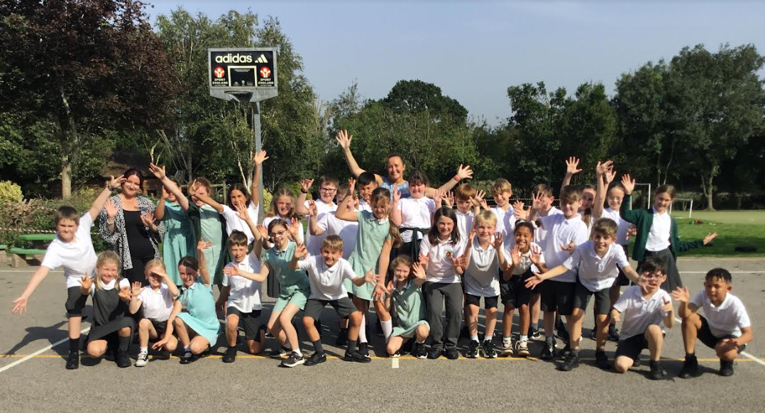
Welcome to Holly class!

Slide 2
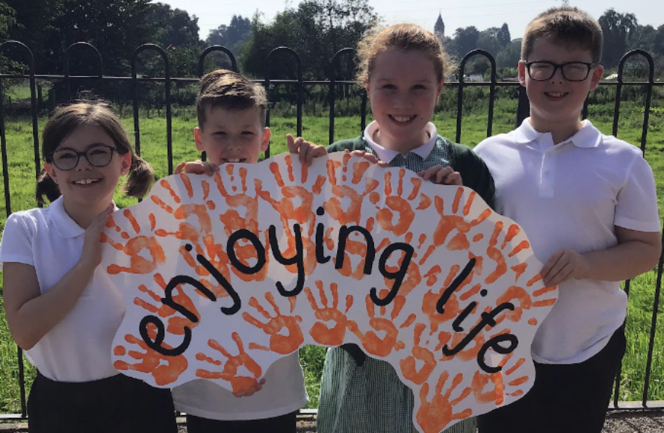
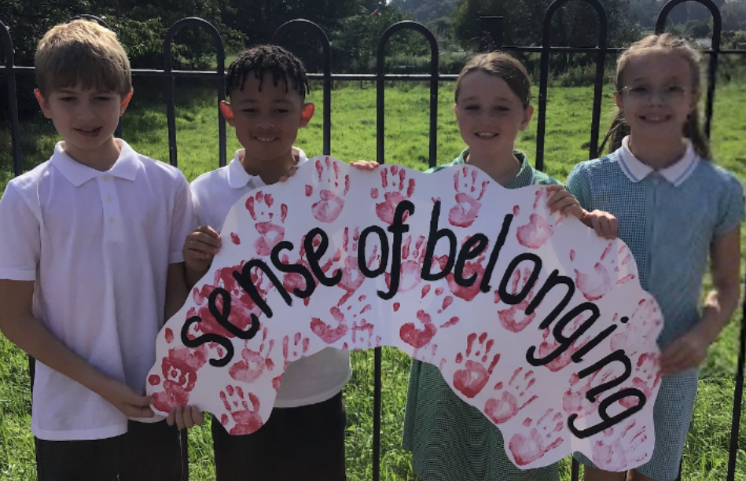
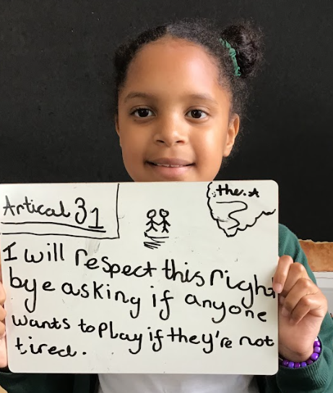
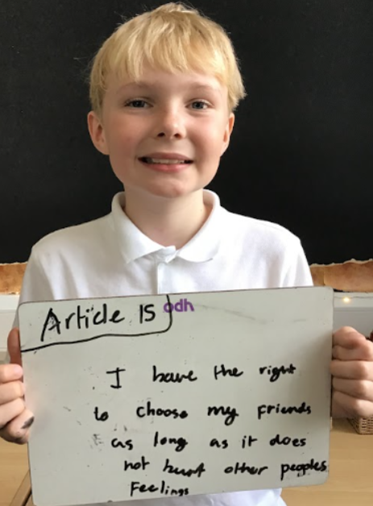
Our Values
‘Our Wonderful World’
Curiosity
Creativity
Broadmindedness
Responsibility
Enjoying life
Sense of belonging.
Behaviour
Ready, Respectful, Safe
Ethos
No Outsiders
Rights Respecting

Slide 3
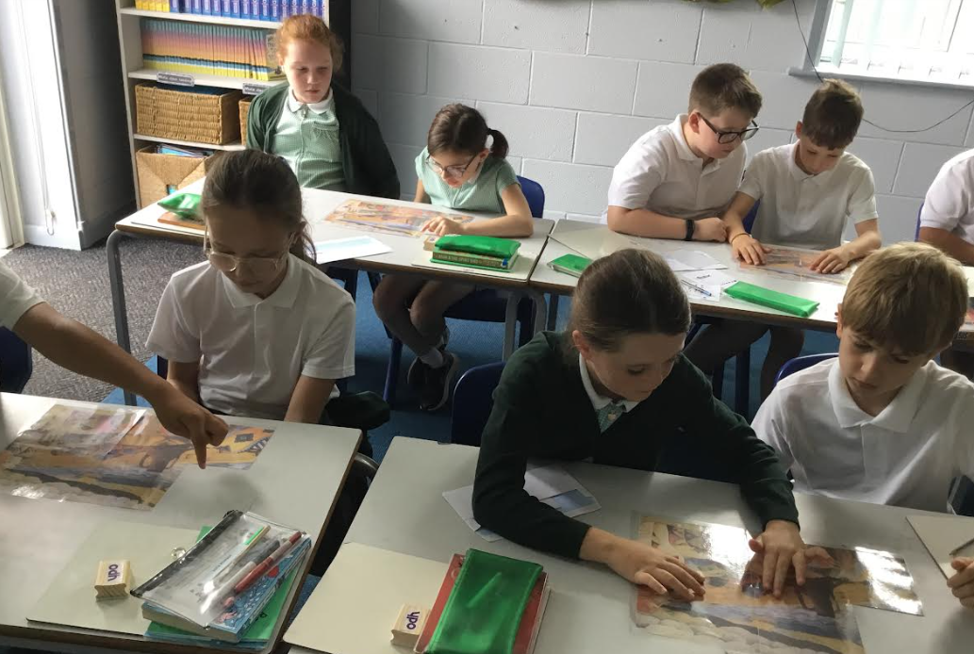
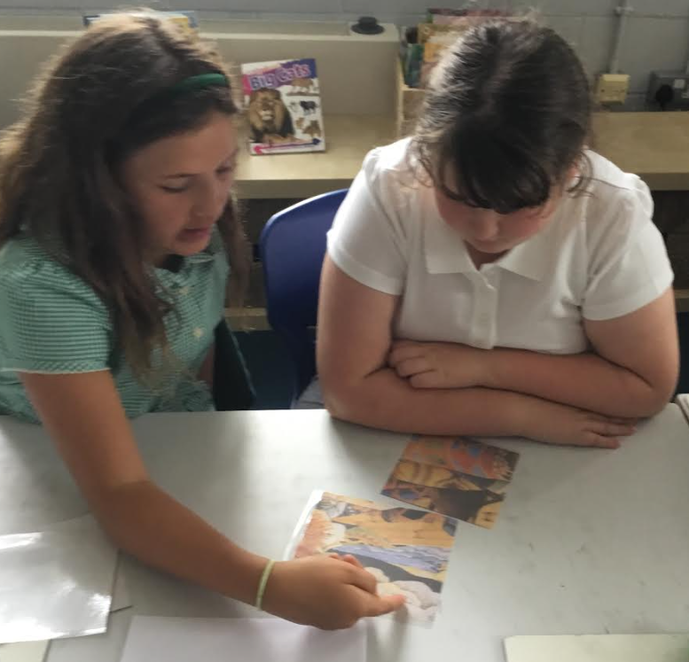
Teaching and Learning
Resilient, collaborative, independent, ambitious, motivated
Ambitious curriculum
Mastery approach and collaborative partners – achievement for all!
Depth not breadth
Mixed ability learning partners – we don’t want to put a perceived ceiling on children’s learning. We assess within the lesson to address misconceptions as they arise and to provide further challenge.
Changed weekly

Slide 4
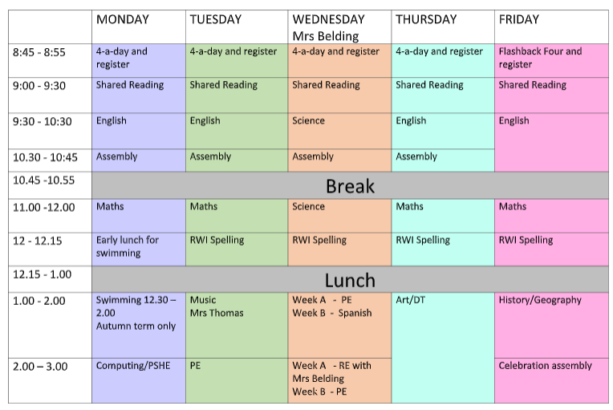
Timetable

Slide 5
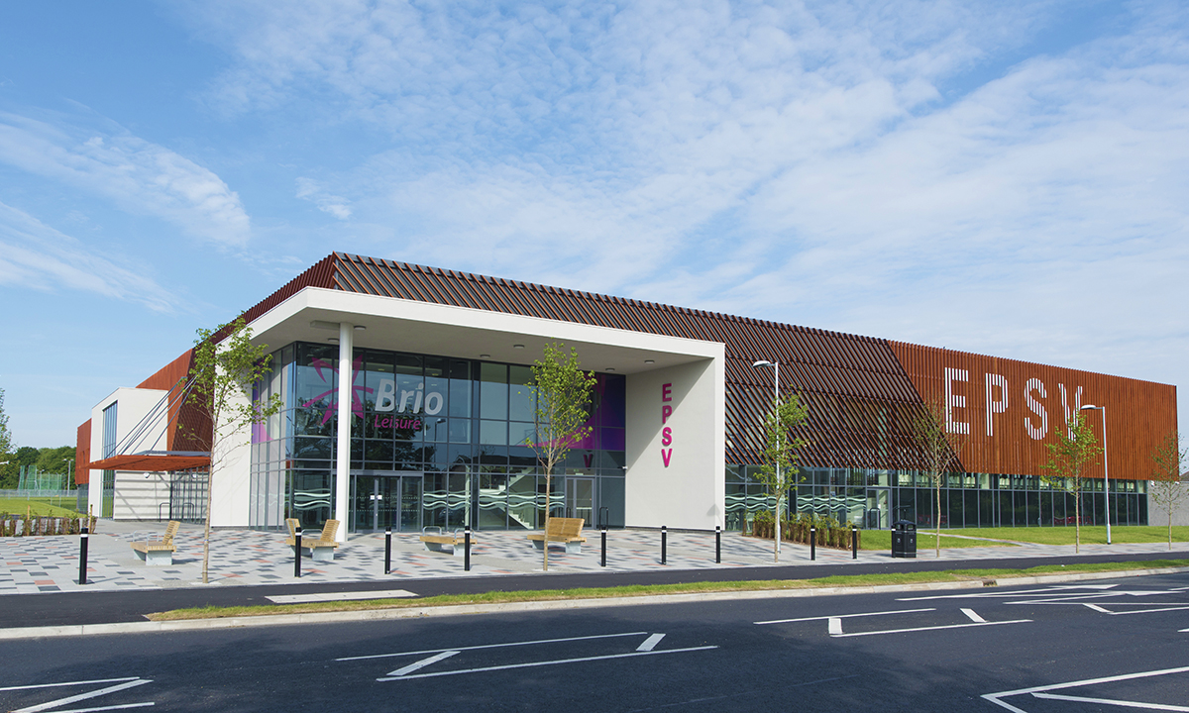
Swimming
Autumn term from Monday 11th September
Leave school at 12.30
The swimming lesson is 1.00 -1.30
We should be back at school for 2pm
Please remove earrings that morning or make sure the children can remove them themselves

Slide 6
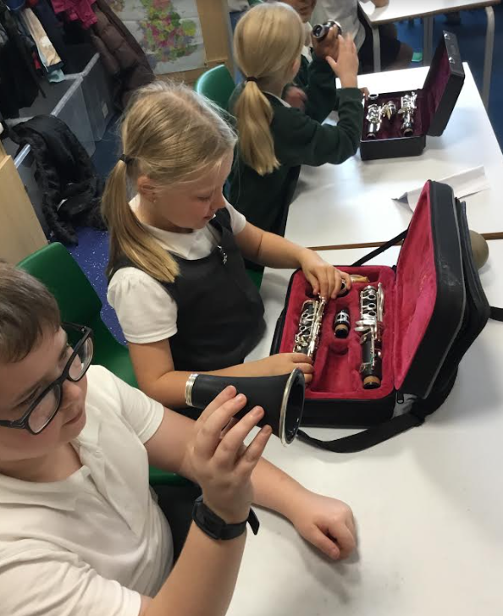
Music
Mrs Thomas teaching Y5 and 6 music curriculum primarily through clarinet but will incorporate other musical platforms
Amazing for brain development and has a positive impact on other curriculum areas
Please encourage regular practice at home – little and often is better than less frequent longer sessions
Please send in instrument loan agreements if you haven’t already
Instruments in every Tuesday please

Slide 7
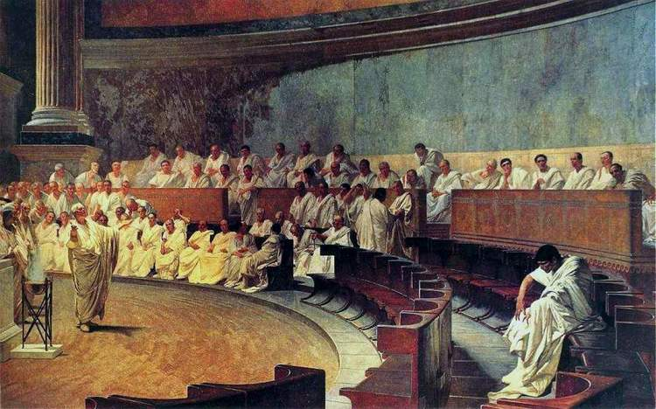
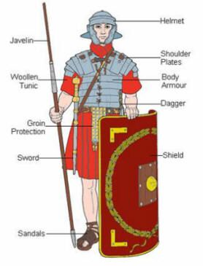
Autumn Term Ancient Rome
Roman Senate

Slide 8
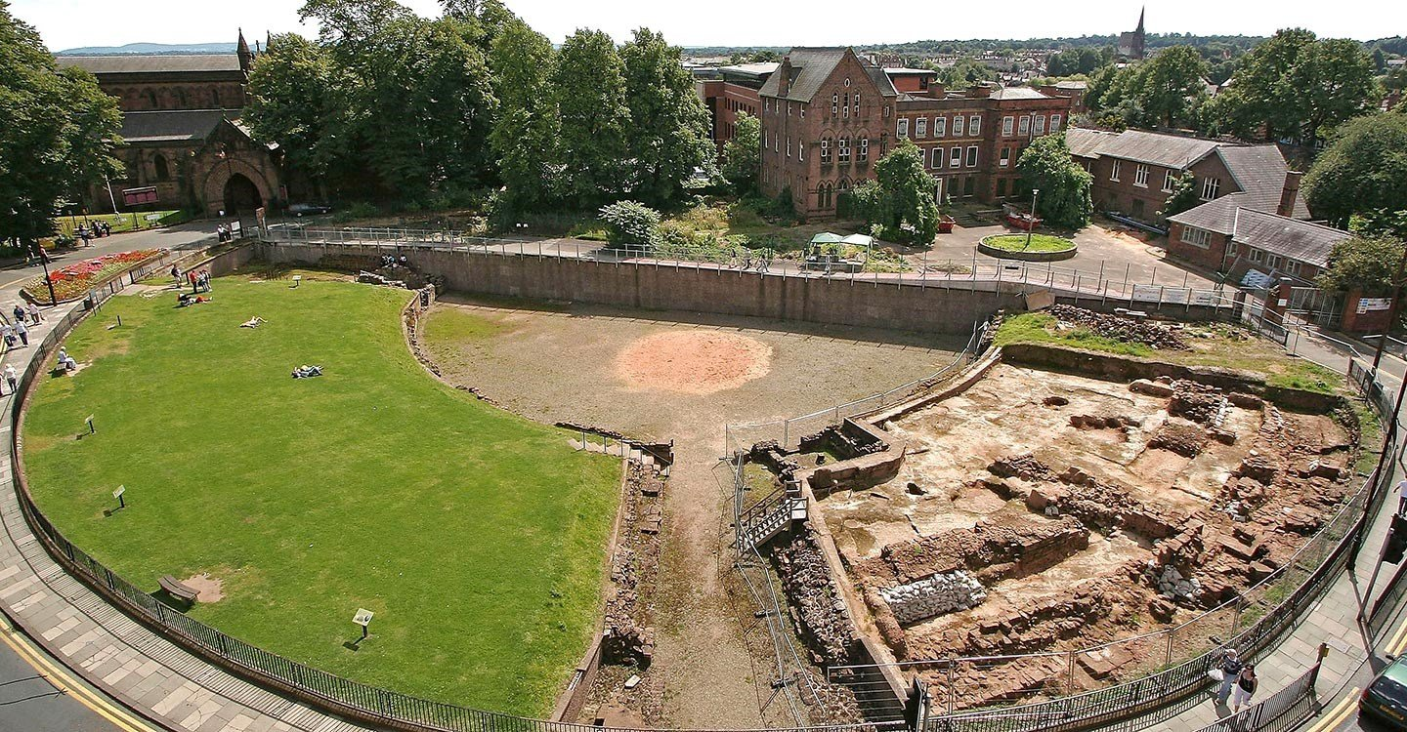
Roman trip!
Thursday 28th September
Letters to be sent shortly

Slide 9
Spring Term Hunting and animal conservation

Slide 10
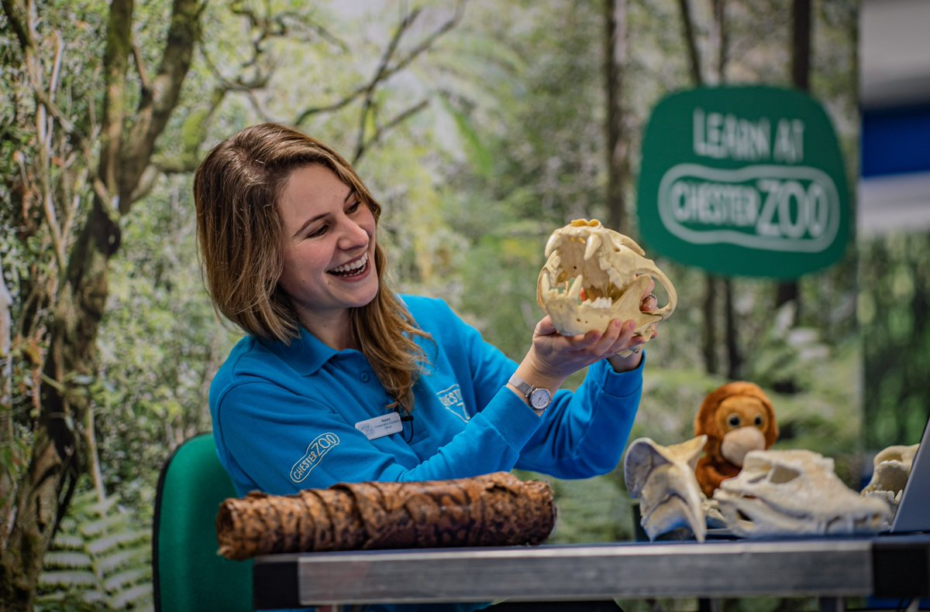
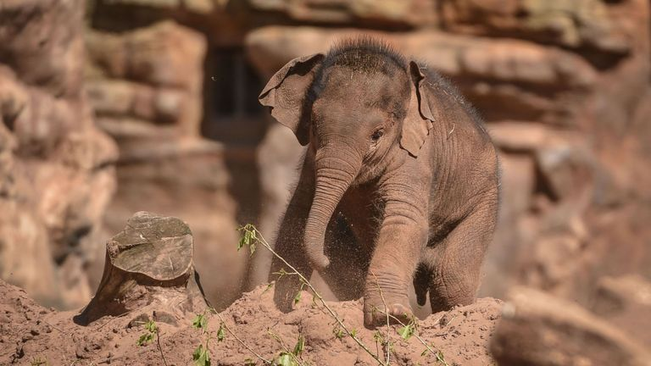
Chester Zoo trip
Spring TBC

Slide 11
Summer Term To infinity and beyond

Slide 12
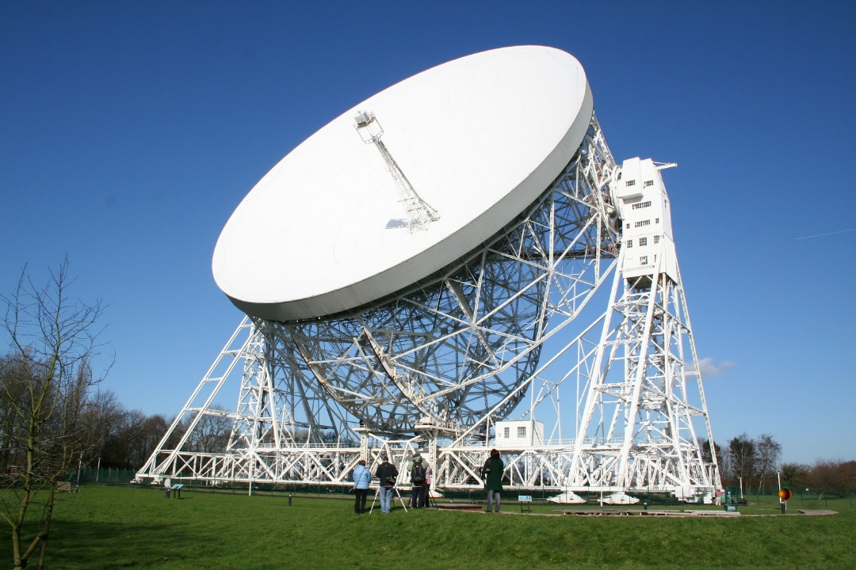
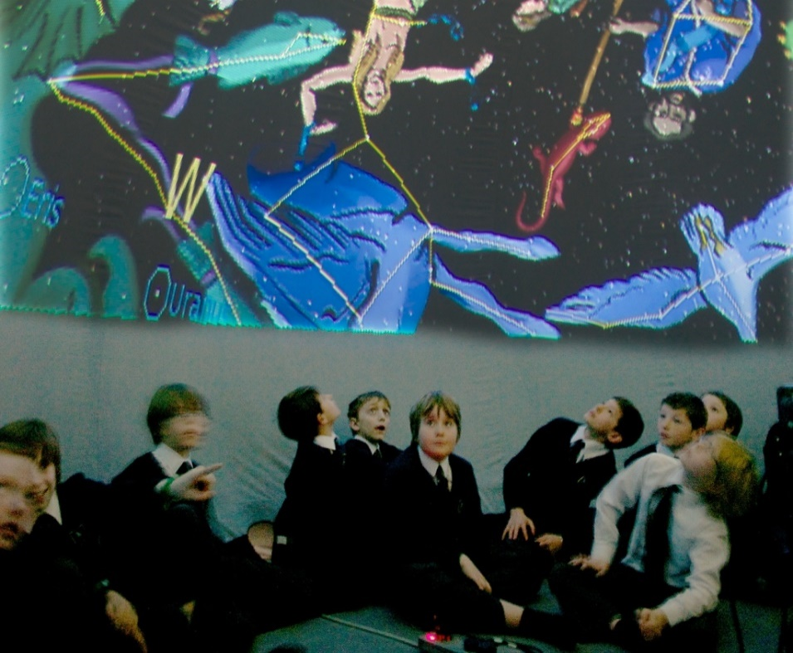
Jodrell Bank Date tbc

Slide 13
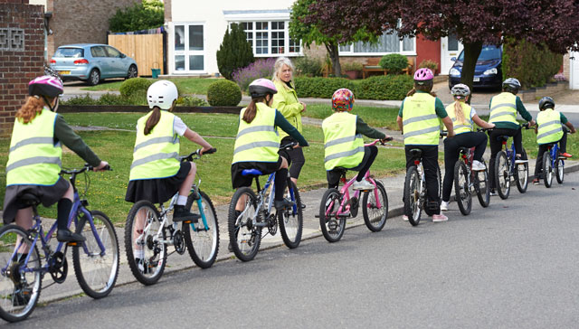
Bikeability
6 children per day
Bring in a bike and helmet
Spring term
Your child will take part for one day during that week.
Please see me if you have any questions/issues beforehand.

Slide 14
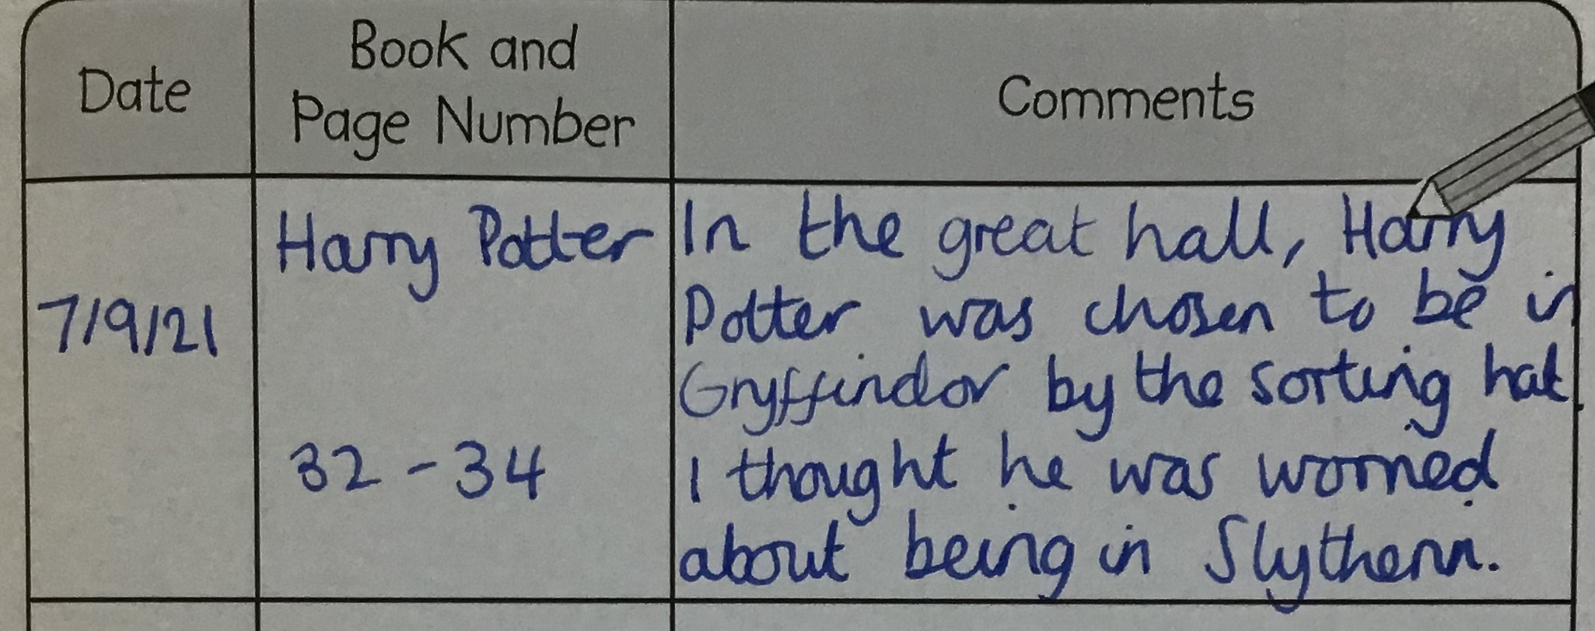
Reading
Please bring diaries in each day
Encourage children to be independent - brief comment about what they enjoyed or anything interesting they found out. Could include any new vocab they’ve encountered.
Strive for 5 (times a week)
We are passionate about all children developing a love of reading.
Huge impact on their academic success and
beyond!
Motivation for reading can be improved by finding books that are of interest to them, by achieving success and seeing themselves as a reader.

Slide 15
Recommended books for Year 5
https://www.thereaderteacher.com/year5
https://www.booksfortopics.com/year-5
https://www.booksfortopics.com/upper-ks2-graphic-novels
https://images.scholastic.co.uk/assets/a/c5/0e/creating-a-reading-spine-hand-out-2137908.pdf

Slide 16
Quality Book Talk
Talk with them about the story and why certain things happened.
Discuss characters’ thoughts, feelings, behaviour and motivations – Model thinking out loud “I think he’s done that because he’s jealous.”
Discuss likes and dislikes, things they found strange, funny, scary etc.
Link events to each other – “Ah THAT’S why he did that.”
Pose questions – I wonder why he’s saying that. How would you feel if you were in that situation? Do you think she regrets doing that?
Listen and respond to their opinions and offer your own.
Help them understand and use new vocabulary – give them context, show a picture, make it stick by thinking of imagery or humour, use it in everyday life.
However, it’s important to just read and enjoy too! Too much stop/start reading can zap the enjoyment. Think about when it’s useful to intervene e.g. If there’s some less familiar vocabulary or if there’s some inference that the child might not have picked up on or understand.

Slide 17
Times table rockstars 15 minutes per week minimum
10 mins on Garage and 5 mins on Studio

Slide 18
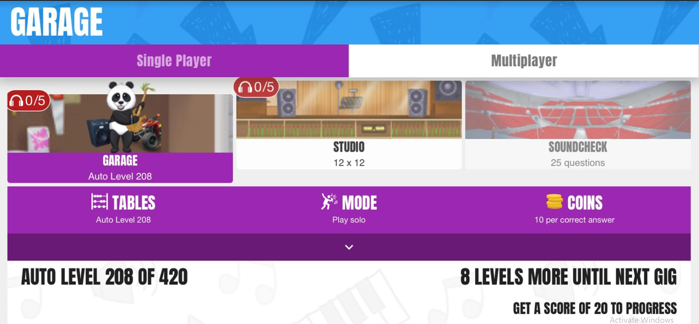
Garage or studio?
Garage mode – automatically selects based on baseline assessment
Studio – up to 12x12 to improve speed
Replicates Year 4 multiplication test

Slide 19
Communication
Weekly newsletter sent by email and on the website
Twitter
Seesaw – to share work.
Email admin@childerthornton.cheshire.sch.uk and ask for
it to be passed on to me
Brief info can be passed over on the playground in the morning. If you wish to discuss anything in more detail please call or email to arrange an appointment.
If you have any questions or wish to discuss any aspect of your child’s development or learning then please don’t hesitate to get in touch.
Parents’ evenings Wednesday 1st and Thursday 2nd
November

Slide 20
Thank you!

