Slide 1
Welcome to Year 3

Slide 2
Teachers
Miss Silcox- Monday- Wednesday
Mrs Hughes- Wednesday- Friday
J

Slide 3
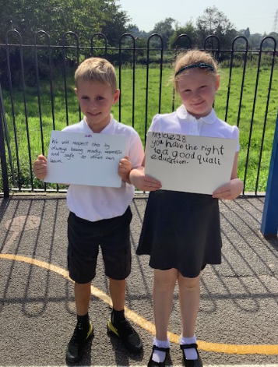
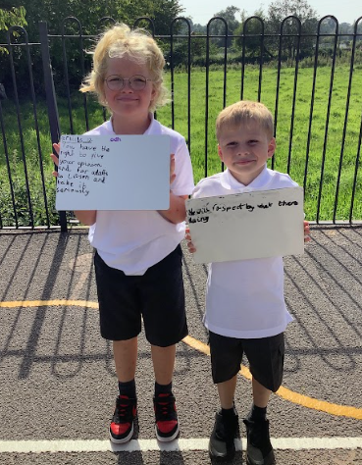
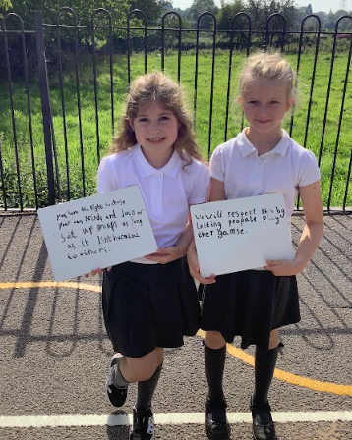
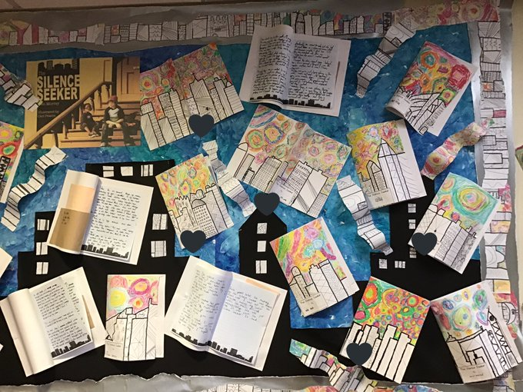
Our Values
Curriculum
‘Our Wonderful World’
Curiosity, creativity, broadmindedness, responsibility, enjoying life, sense of belonging.
Behaviour
Ready, Respectful, Safe
Ethos
No Outsiders
S

Slide 4
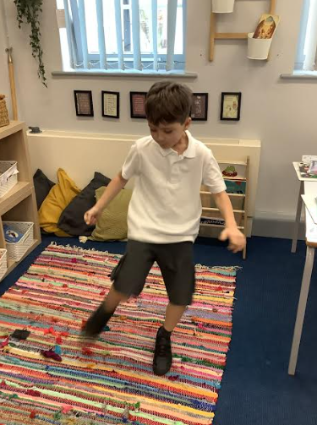
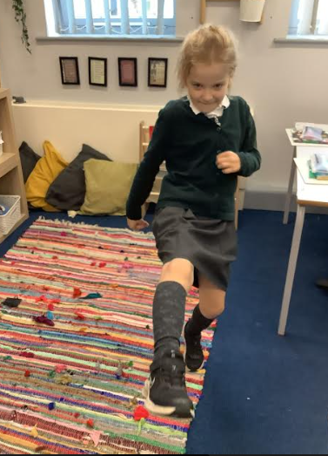
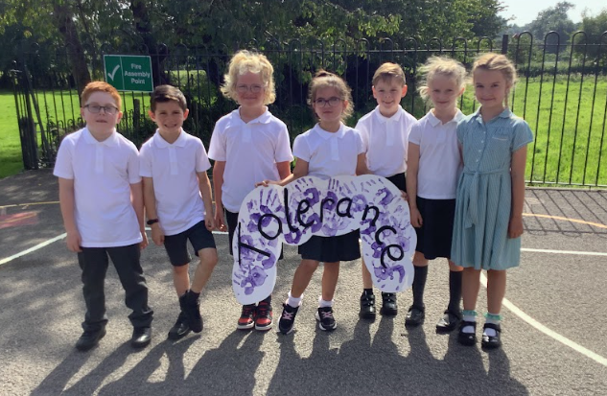
Teaching and Learning
Resilient, collaborative, independent, ambitious
Mastery approach – achievement for all!
Depth not breadth
J

Slide 5
Maths and English
Power Maths
Lots of talk and collaboration
Concrete, pictorial and abstract
Pathways English- mastery of objectives. Short tasks building on prior learning with a longer piece pulling it all together at the end of a unit.
S

Slide 6
Phonics/ Shared reading
Some children will do Read Write Inc sessions to support their phonic knowledge.
In class we will be doing shared reading as a whole class. This focuses on comprehension skills whilst reinforcing decoding skills learned in KS1.
J

Slide 7
PE
PE coach – Mr Grooms
Please ensure your child has their PE kit in school all week and make sure it is labelled.
Earrings need to be out, plasters/tape provided, or child able to take out
Laces
PE day Wednesday but extra sessions can happen
SWIMMING- Summer term. Voluntary contribution for transport. All children expected to attend unless medical note from the doctor.
S

Slide 8
Topic
Autumn- Blue Planet. Looking a bodies of water. Specifically canals and the history of Ellesmere Port. Focusing on how these are being polluted by plastic and how we can reduce this.
Spring- Adrift. Looking at refugees. What refugees are, where many come from and go to and if the rights of the child are being granted to refugees.
Summer- Through the ages. Focus on Stone Age through to Iron Age. Exploring pre history and the changes that took place during this time. Evaluating what and how we know about pre history and the limitations of our knowledge.
J

Slide 9
Reading
We are passionate about all children developing a love of reading.
Children can begin to write their own comments but adult still needs to write in books regularly.
Encourage to read a range of texts to find what they enjoy.
Try and listen to the children read regularly as this helps with fluency and performance voice. Children can hear errors and self correct.
S
Notes:
Want to develop positive attitudes towards reading
Children will want to read books that are of interest to them

Slide 10
TT Rockstars
Little and often
Repetitive to enable automaticity- may seem easy but children need to be under 2 secs per question to move on
Gigs will assess as the children progress. 1 gig each month
Games- Garage- 15 minutes a week set as minimum.
Studio- 12x12, sets the speed
Soundcheck- Year 4 multiplication check
Arena- Similar to garage but against others
Festival- 12x12, against others
Rockslam- Challenge others 12x12
J

Slide 11
Spelling
Y3 spellings
Log book- children will log words that they need to practise. Taken home daily and returned.
S

Slide 12
End of the day
Children leave from the side gate.
Aware that they must return to the building if no adult is there.
J

Slide 13
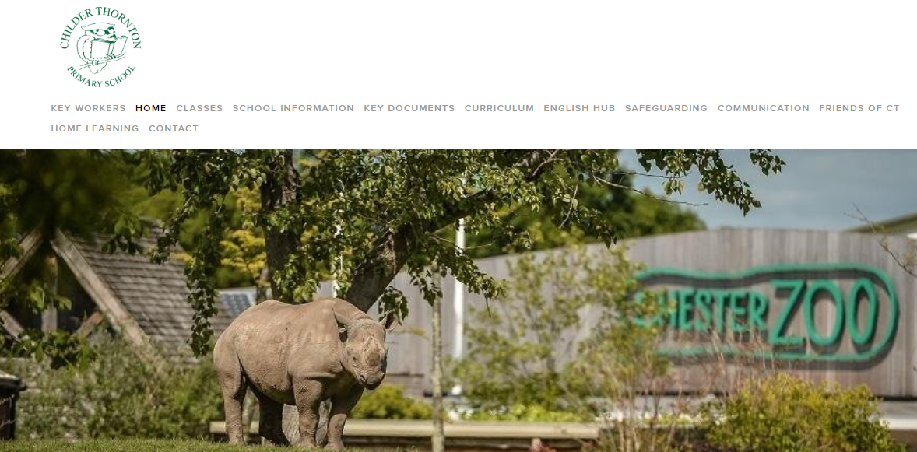
Communication
Newsletter
Parents evening
Twitter
See Saw
Email admin@childerthornton.cheshire.sch.uk
Phone us
s

